Slide 1

PureScript
JS.la
Purely Functional Coding for the JavaScripter
Sean Westfall

Slide 2
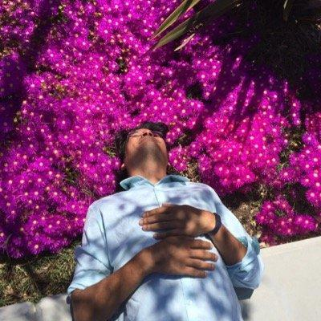
Shout out to Carlo Flores, RIP

